Slide 1



Week 12: QA Day
SPRINT 4 KICKOFF
QA + Refactor + Professional Polish
Today's goal:
Prove the app is real.
Week 12 QA Day / 1/28

Slide 2




The Big Shift
The Big Shift
messy feature chaos
Build less.
Verify more.
Fix what matters.
• new buttons
• unclear scope
• no proof
reliable sprint work
• tests / issues
• owners / evidence
Sprint 4 is not feature chaos.
Sprint 4 is reliability.
Week 12 QA Day / 2/28

Slide 3


Why This Week Matters
Evidence Missing
Activity is not verified progress. Audit shows significant gaps in documentation.
Week 10 Audit Findings:
lots of activity
weak traceability
too much feature expansion
unclear bug evidence
missing AI-use notes
inconsistent receipts
Activity is not the same as verified progress.
Week 12 QA Day / 3/28

Slide 4


Today’s Goal
By the end of class, every team has:
QA checklist
tested MVP flow
bug severity list
GitHub Issues for major bugs
evidence links
next actions
Week 12 QA Day / 4/28

Slide 5
Weekly Progress Presentations
1
2
3
4
5
What changed?
Show improvement.
Show evidence.
Random member explains.
Ask / blocker.
Requirements & Expectations
5 minutes per team
No slides required.
Show the app, repo, board, PRs, Issues, tests, and docs.
Evidence-based progress is the standard.
Week 12 QA Day / 5/28

Slide 6
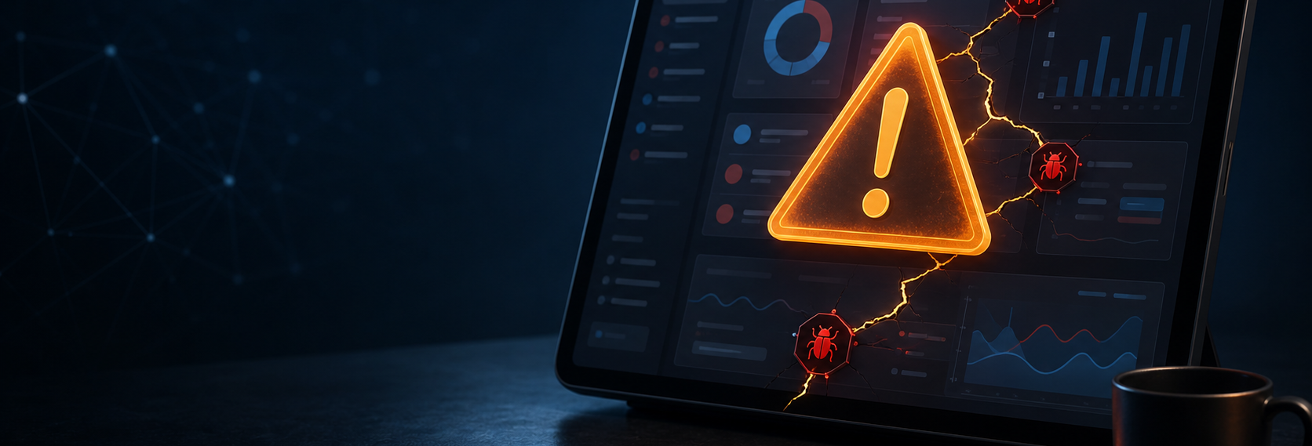
Presentation Question
What would break your final demo right now?
That is today’s most important question.
Identify the single point of failure before it happens in front of the stakeholders.
Week 12 QA Day / 6/28

Slide 7
QA Is Not “Click Around”
QA Is Not “Click Around”
Weak QA
Strong QA
“It works.”
“We tested it.”
“No bugs.”
no links
checklist
pass/fail results
screenshots
issues
owners
VAGUE
EVIDENCE
Week 12 QA Day / 7/28

Slide 8
QA Day Workflow
01
02
03
04
05
06
Write core MVP flow
Create test checklist
Run tests
Log bugs
Assign severity
Update Sprint Packet
Update Sprint Packet
Week 12 QA Day / 8/28

Slide 9
Core MVP Flow
Core MVP Flow
Write your main user flow in 3–6 steps. If you cannot describe the flow, you cannot test it.
01
02
03
04
05
User signs up
User logs in
User creates item
User views saved item
User edits or deletes item
EXAMPLE:
The flow represents the critical path a user takes to achieve value. Map each major interaction as a discrete step.
Week 12 QA Day / 9/28
Week 12 QA Day / 9/28

Slide 10
QA Checklist File
Required Elements
check_circlecore MVP flow
check_circletest cases
check_circleexpected result
check_circleactual result
check_circlepass/fail
check_circleevidence
check_circleIssue link
QA_CHECKLIST.md
# Standard Location
docs/QA_CHECKLIST.md
// Example Content
| ID | Test Case | Expected | Actual | Pass/Fail |
|---|---|---|---|---|
| 01 | Login | Home view | Home view | PASS |
Week 12 QA Day / 10/28

Slide 11
Minimum Test Cases
Your QA strategy must include at least 8 tests covering critical application areas.
settings
setup
Environment config and initial states.
trending_up
main flow
The happy path of the core MVP flow.
explore
navigation
Moving between screens and modules.
folder_off
empty state
UI behavior when no data exists.
report_problem
error state
Handling invalid inputs and failures.
save
data save/load
Persistence of user data and settings.
rocket_launch
deployment/demo
Production readiness check.
account_circle
ownership
Clear evidence of individual work.
PRO TIP: A test without an expected result is just a suggestion. Map every interaction clearly.
Week 12 QA Day / 11/28

Slide 12


Bug Severity
Severity is about demo risk and user impact.
P0
Final demo cannot work
Critical failure of the presentation path.
P1
Core feature broken
Essential functionality is non-operational.
P2
Important, workaround exists
Significant issue with an available bypass.
P3
Polish / nice improvement
Minor UI/UX improvements or non-critical fixes.
DEMO RISK
REMINDER: Assign severity based on the objective impact to the end user and presentation readiness.
Week 12 QA Day / 12/28

Slide 13
Effective Bug Reports
Every important bug needs these seven essential components.
assignment_late
SEVERITY & OWNER
How critical is it and who is responsible?
reorder
REPRODUCTION STEPS
Clear sequence of actions to trigger the bug.
compare
EXPECTED VS ACTUAL
Define the discrepancy clearly.
GitHub Issue Mockup
## Severity: P0 - Blocker
## Steps: 1. Login 2. Click Pay...
## Expected: Redirect to success
## Actual: 500 Internal Server Error
severity:P0 evidence
Next Steps & Evidence
Always attach logs, screenshots, or screen recordings.
CRITICAL REMINDER: A vague bug is not useful. Precision saves engineering time.
Week 12 QA Day / 13/28

Slide 14
P0/P1 Rule
P0/P1 bugs must become GitHub Issues today.
• No exceptions.
• No hiding the bodies.
GitHub Issue Requirements
1. Severity: P0 or P1
2. Steps: Clear reproduction sequence
3. Expected: What should happen
4. Actual: What actually happened
5. Evidence: Logs, screenshots, video
6. Owner: Responsible engineer
7. Next Step: Immediate action plan
severity:P0evidence
Week 12 QA Day / 14/28

Slide 15

Evidence Examples
check_circle Good Evidence
• PR link
• Issue link
• Screenshot
• Test output
• CI run
• Demo video
• Docs commit
cancel Bad Evidence
• “almost done”
• “we talked”
• “AI fixed it”
• “on my laptop”
Week 12 QA Day / 15/28

Slide 16

AI Use During QA
check_circle AI can help:
suggest test cases
explain errors
draft bug reports
review edge cases
cancel AI cannot replace:
running the app
testing
understanding
evidence
Week 12 QA Day / 16/28

Slide 17
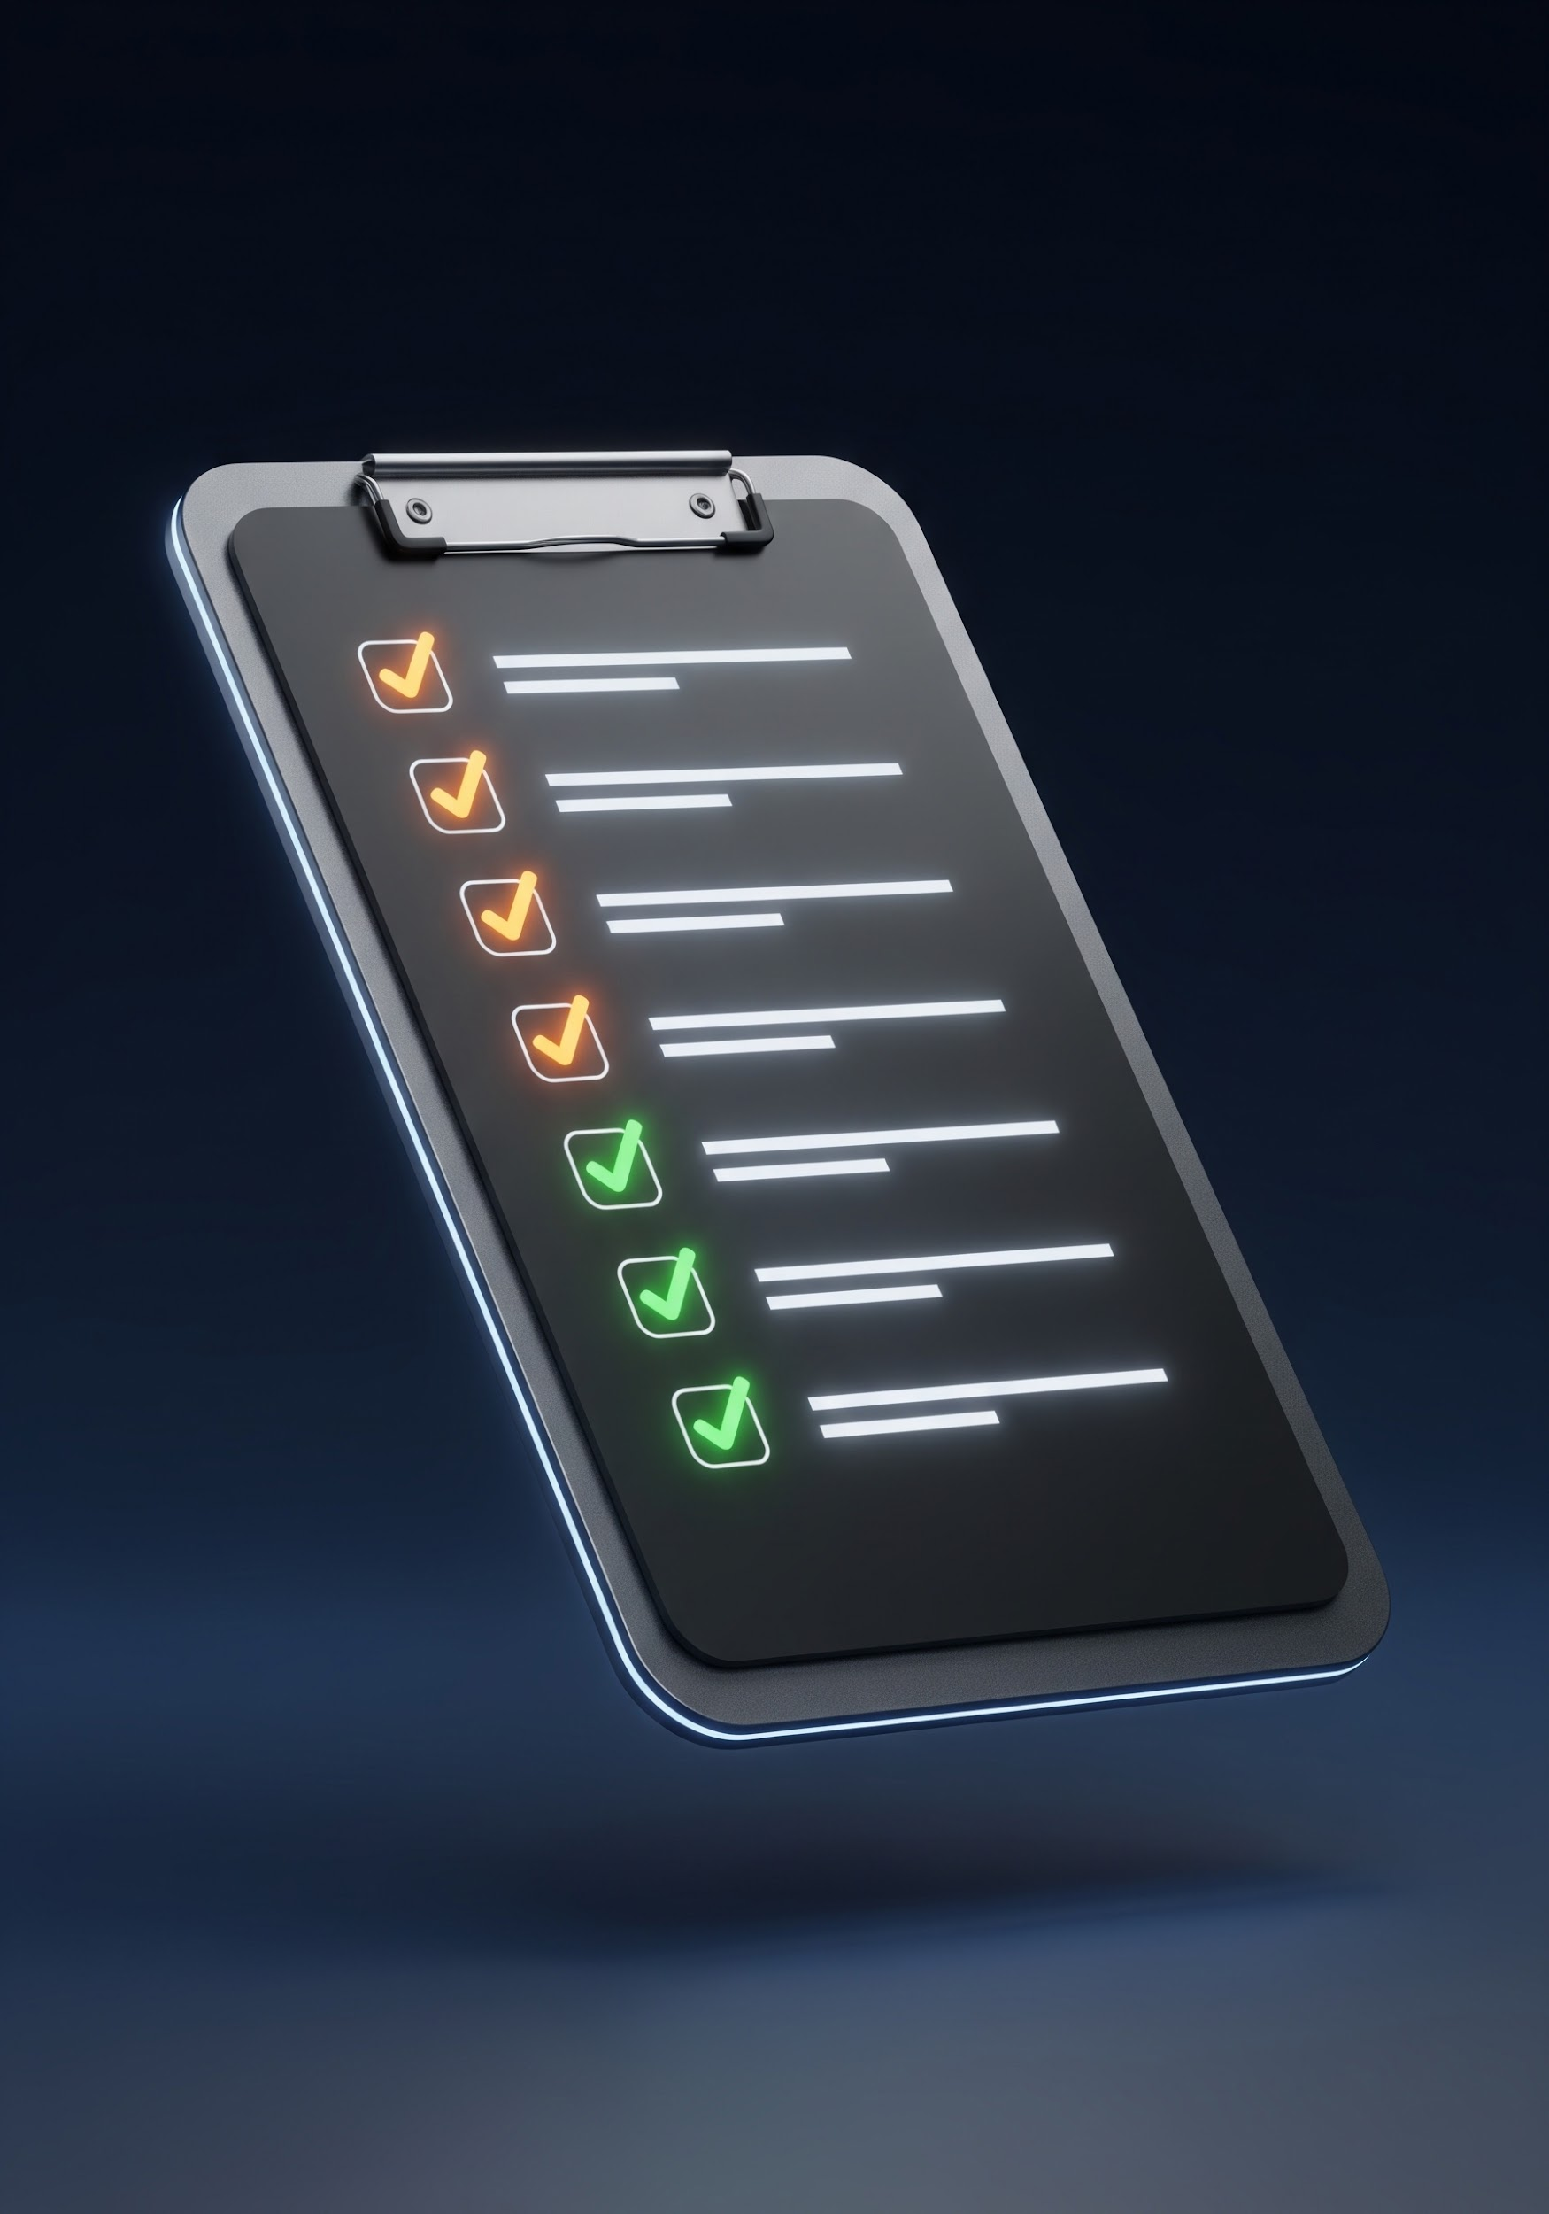
Studio Block 1
Task: Create the QA Checklist
Output: [Insert Checklist Reference]
Easy Win:
Write the core MVP flow first.
Week 12 QA Day / 17/28

Slide 18
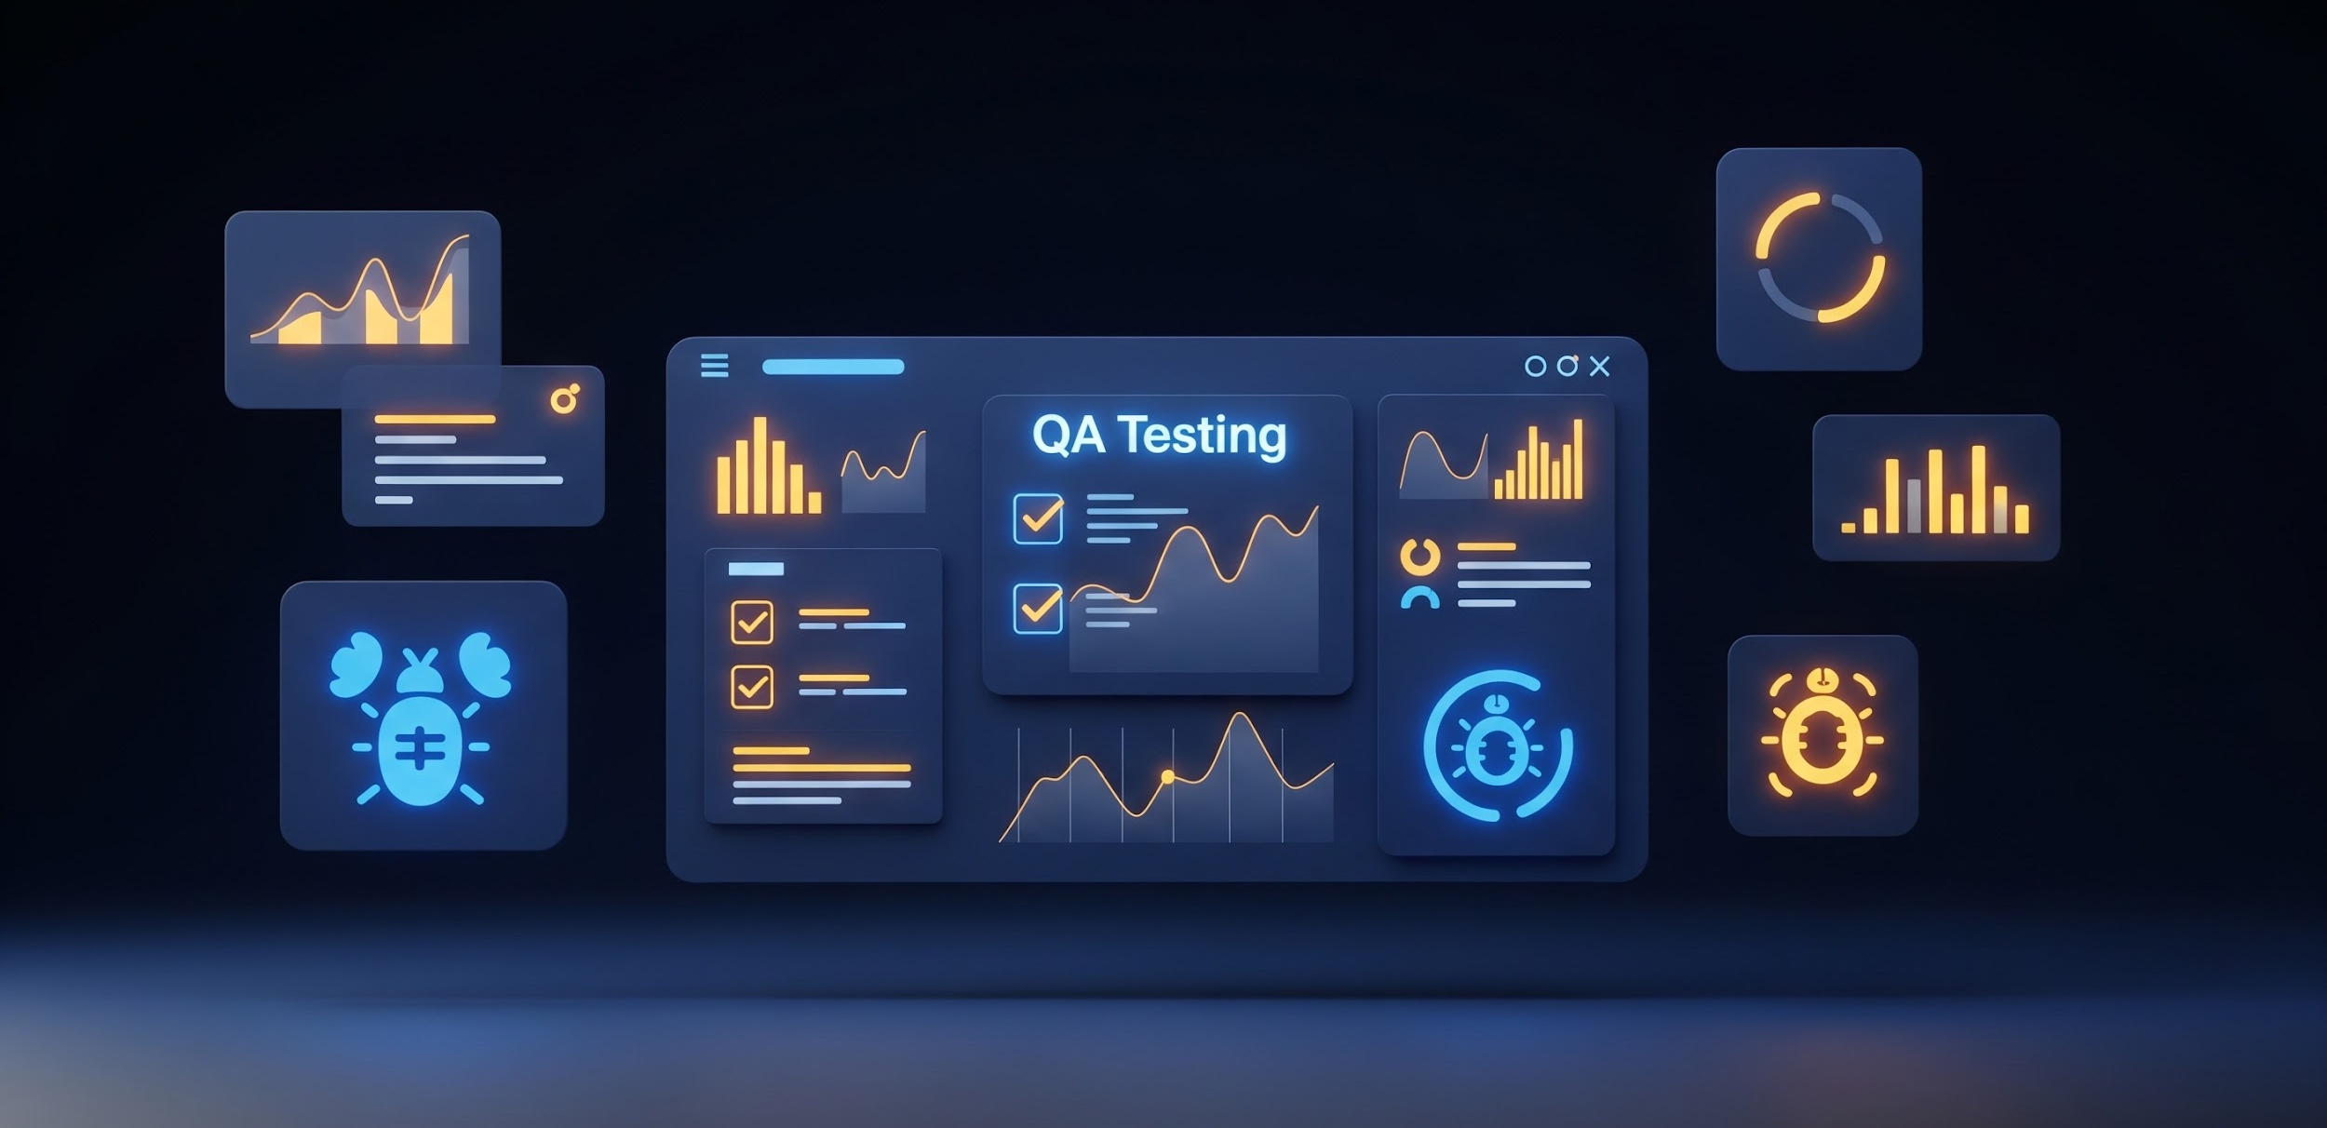
Studio Block 2
Run the Tests
For each row in your checklist, complete every field. Precision is key for high-quality QA reporting.
assignment expected result
What the feature should do according to requirements.
visibility actual result
What actually happened when you performed the test.
CRITICAL: Do not leave blanks. Every test must be documented.
thumbs_up_down pass/fail
Binary outcome based on the comparison of results.
attachment evidence
Screenshots, logs, or recordings proving the result.
Week 12 QA Day / 18/28

Slide 19
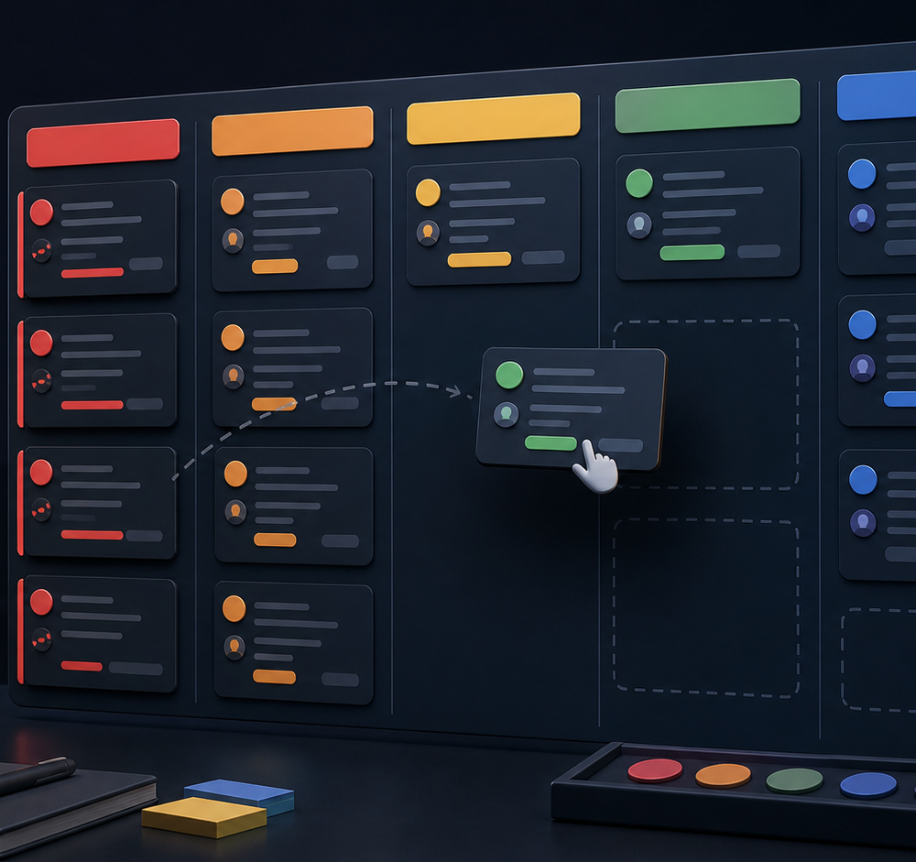
Studio Block 3
Bug Triage Process
For each failed test, follow these essential steps to ensure comprehensive QA reporting and resolution tracking.
priority_high
Assign Severity
Define the impact level (P1-P4).
add_task
Create Issue
Log a formal ticket in the tracking system.
person_add
Assign Owner
Identify the developer responsible for the fix.
link
Link Evidence
Attach screenshots, logs, or recordings.
dashboard_customize
Update Board
Ensure status reflects current triage state.
Week 12 QA Day / 19/28

Slide 20
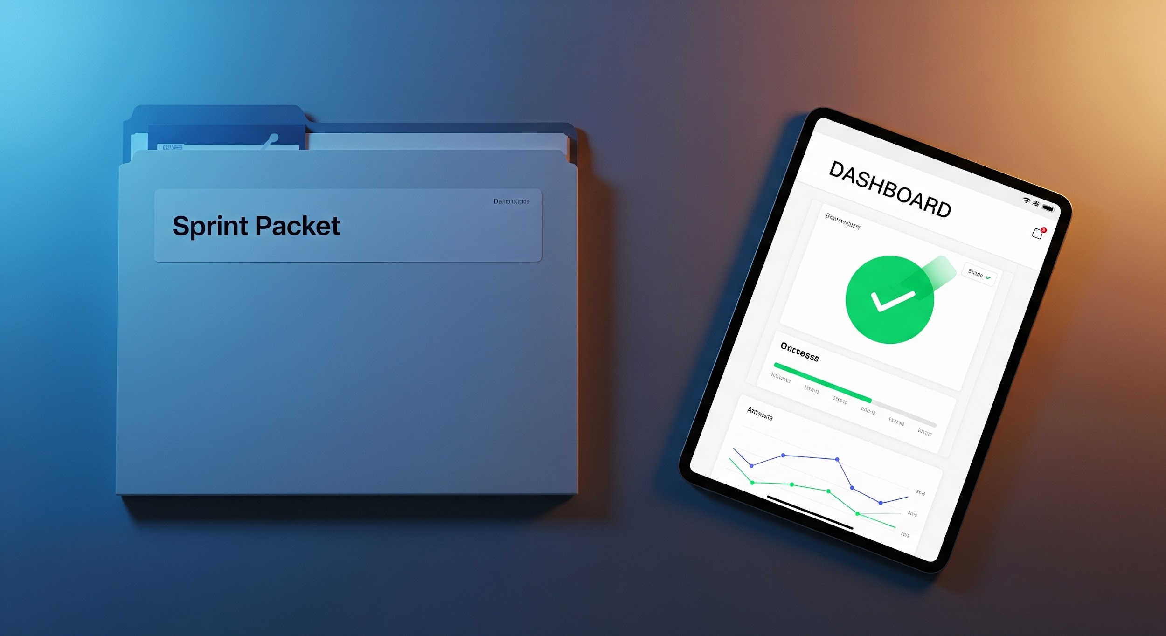
Studio Block 4
Prepare Friday Sprint Packet
Your final submission must contain the following verified components.
fact_check QA checklist link
Direct access to the completed testing log.
report_problem bug severity list
P1-P4 breakdown of all identified issues.
camera_alt board snapshot
Visual capture of the current sprint board status.
attachment testing evidence
Logs, recordings, and validated results.
psychology AI ownership check
Mandatory disclosure of AI tool usage.
receipt_long individual receipts
Proof of contribution from each team member.
Week 12 QA Day / 20/28

Slide 21
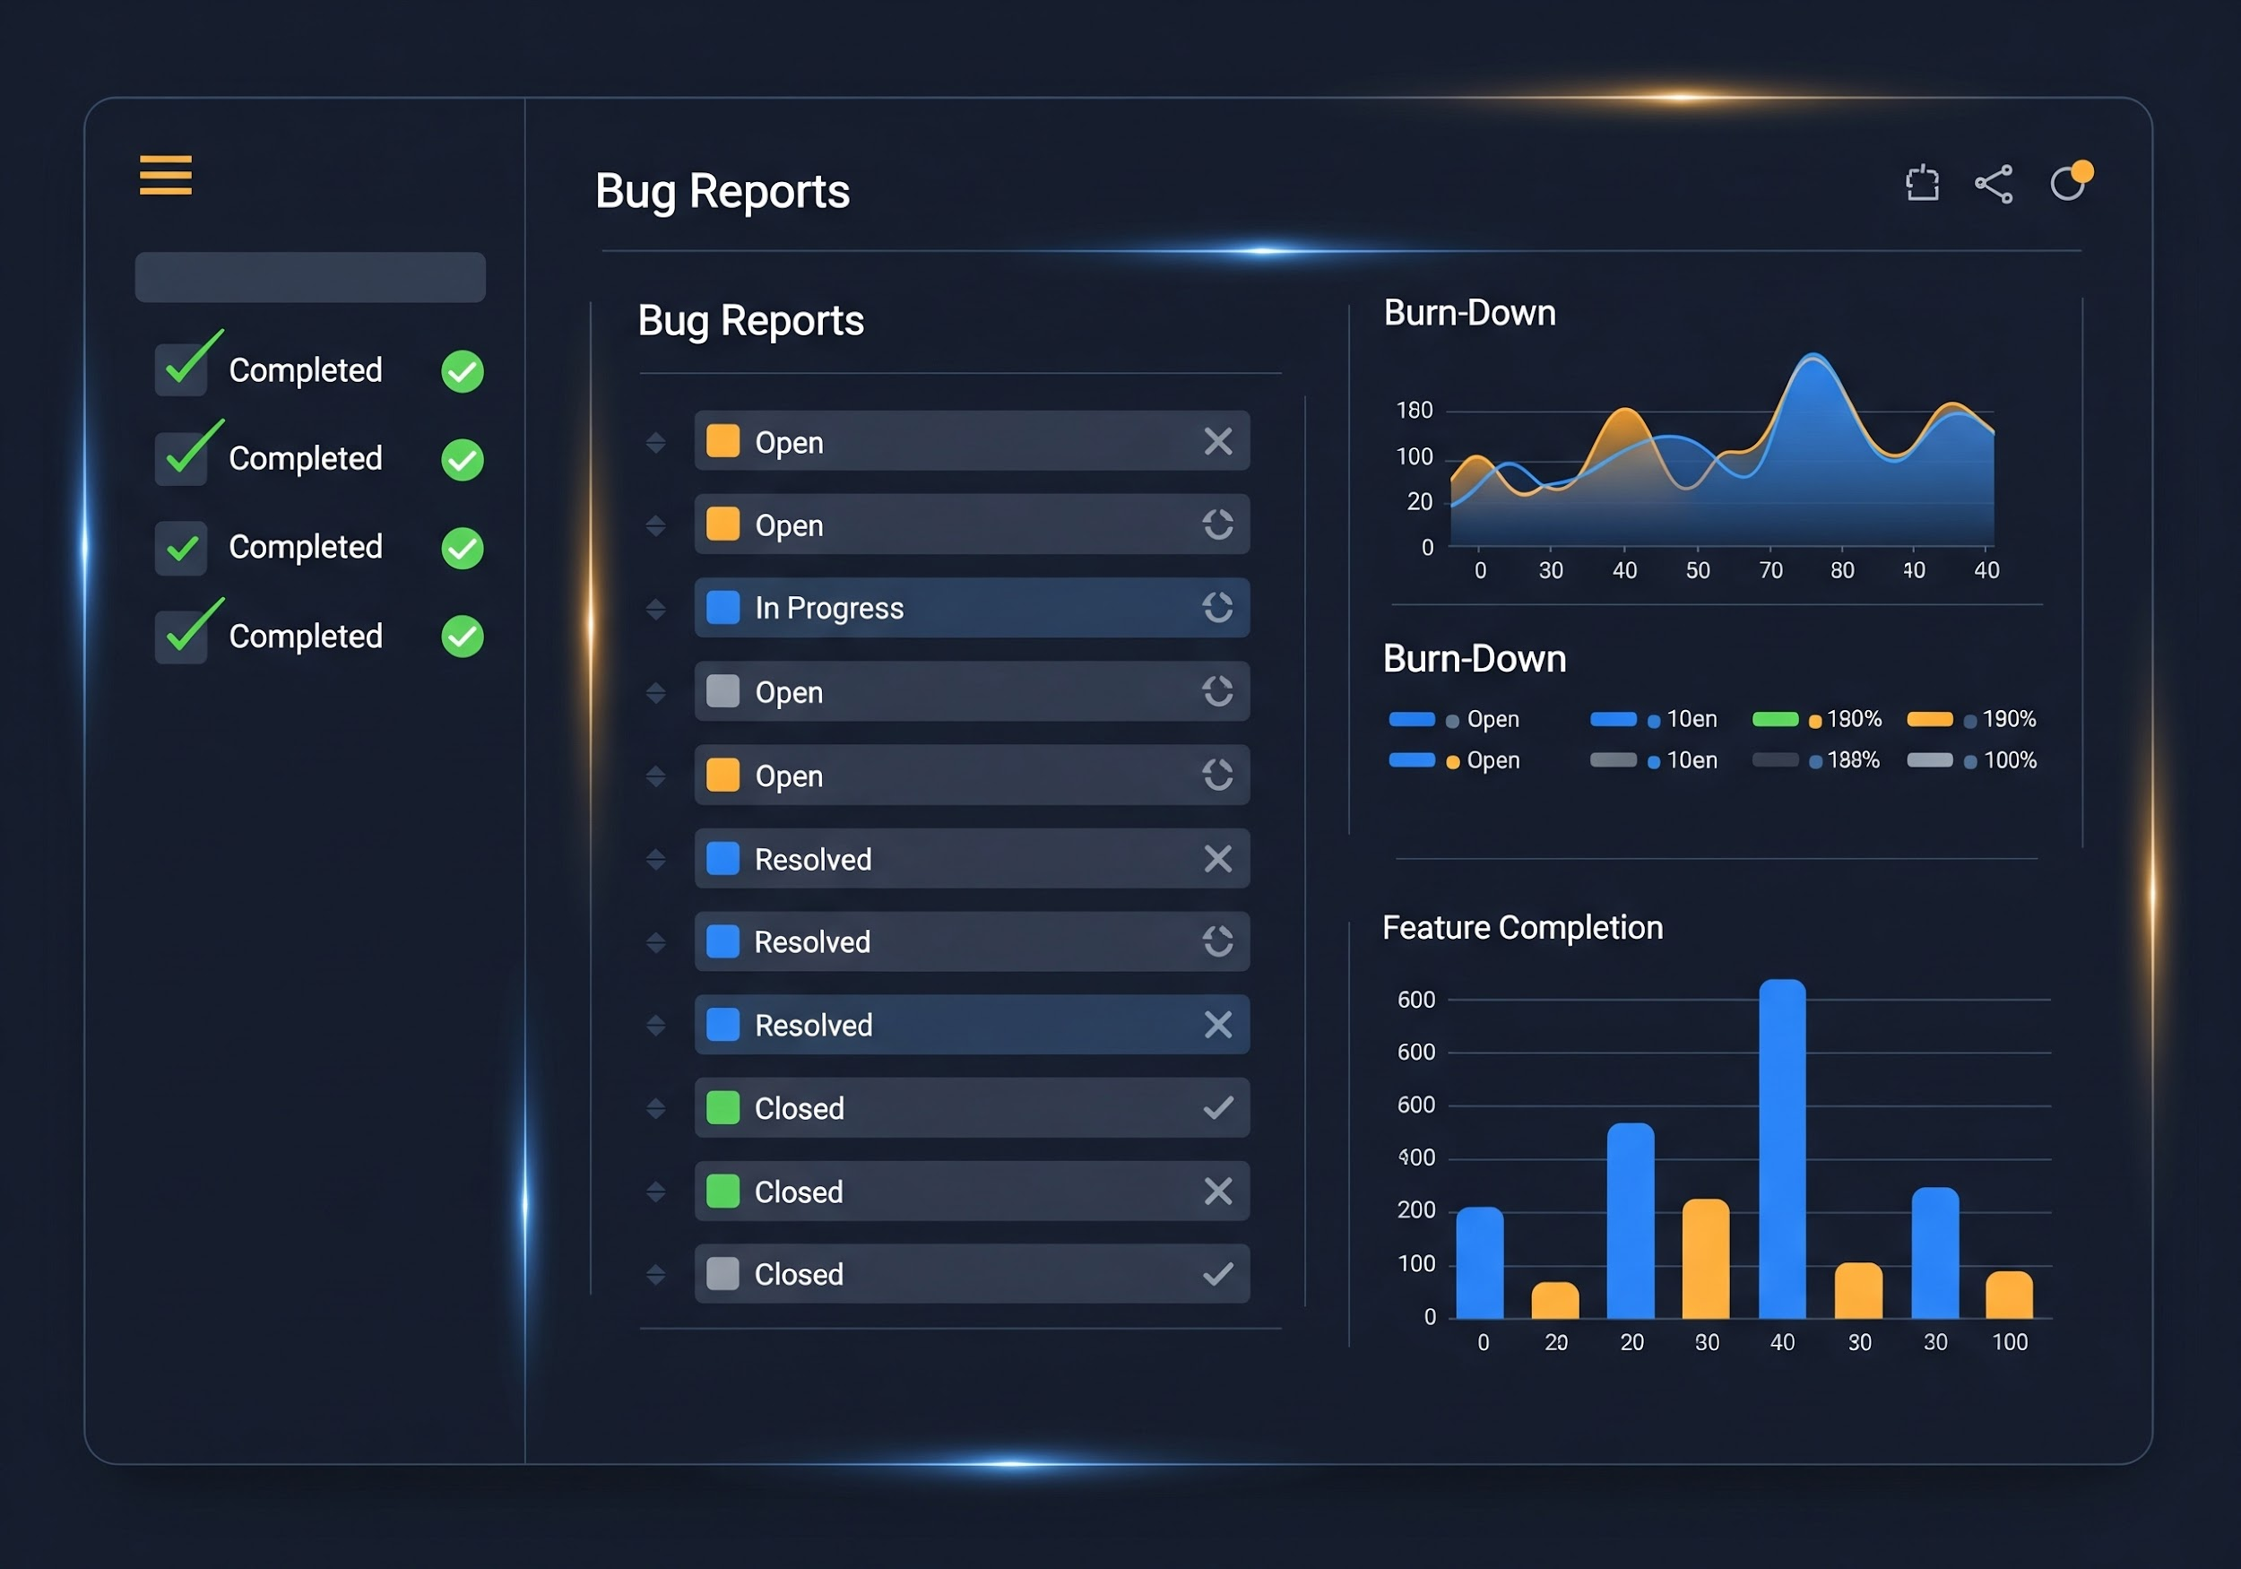
What Good Looks Like
A good team can say:
"We tested our main flow, found 1 P1 and 3 P2 bugs, created Issues, assigned owners, and linked evidence."
That is professional progress.
Week 12 QA Day / 21/28

Slide 22
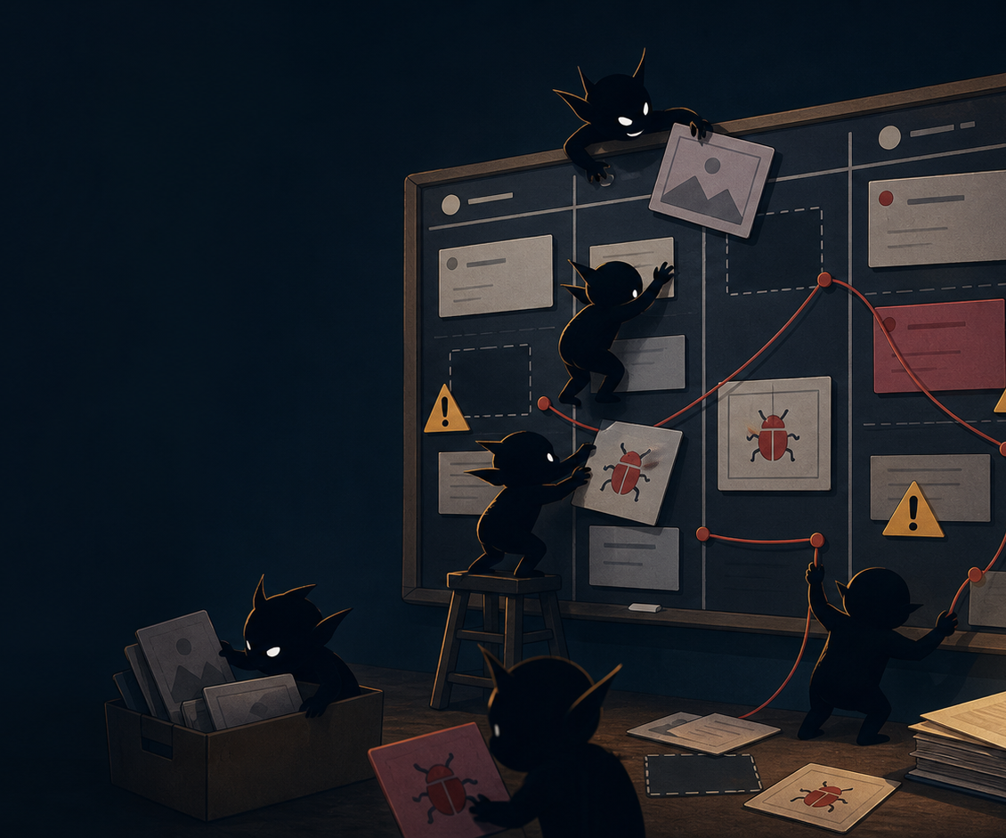
Common Mistakes
Avoid these common pitfalls during QA:
adding features before testing
report_problem
vague “bug fixing” & no screenshots
missing owners or Issue links
no AI-use note or receipts
These are fixable. Fix them today.
Week 12 QA Day / 22/28

Slide 23
Exit Checkpoint
Complete these tasks before you leave today:
QA checklist exists
check_box_outline_blank
8+ tests written
check_box_outline_blank
tests run
check_box_outline_blank
bugs triaged
check_box_outline_blank
P0/P1 Issues created
check_box_outline_blank
board updated
check_box_outline_blank
Friday packet started
check_box_outline_blank
Week 12 QA Day / 23/28

Slide 24

Closing
A visible bug is useful.
A hidden bug is dangerous.
A vague bug is homework goblin behavior.
Fix the goblins.
Week 12 QA Day / 24/28

Slide 25
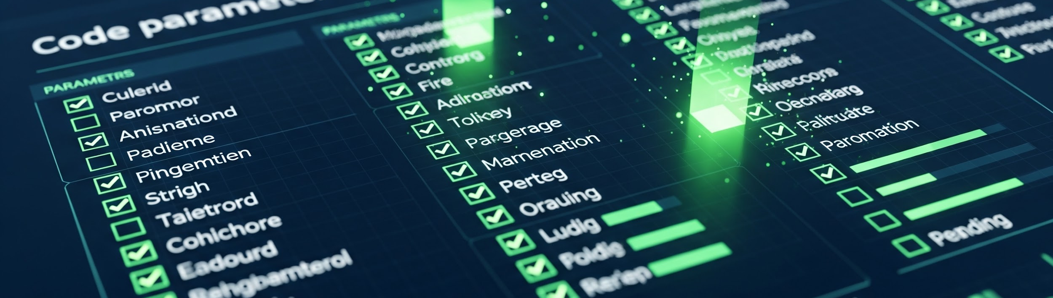
Friday Submission Checklist
Friday Sprint Packet must include:
Weekly Progress Demo evidence
testing evidence
QA checklist link
AI Use + Code Ownership Check
bug severity list
individual receipts
board snapshot
Week 12 QA Day / 28/28

